Slide 1
Navigating the Future of Online Shopping
A Python & SQL Analytics Project
Presented by Vishal Maurya

Slide 2
Project Overview
Objective: Gain actionable insights from e-commerce sales, customer, and product data.
Data Sources:
Customers
Orders
Order Items
Sellers
Products
Payments

Slide 3
Data Cleaning & Preparation
Addressed missing values and removed duplicates.
Standardized categories and data types.
Ensured reliable results for analytics.

Slide 4
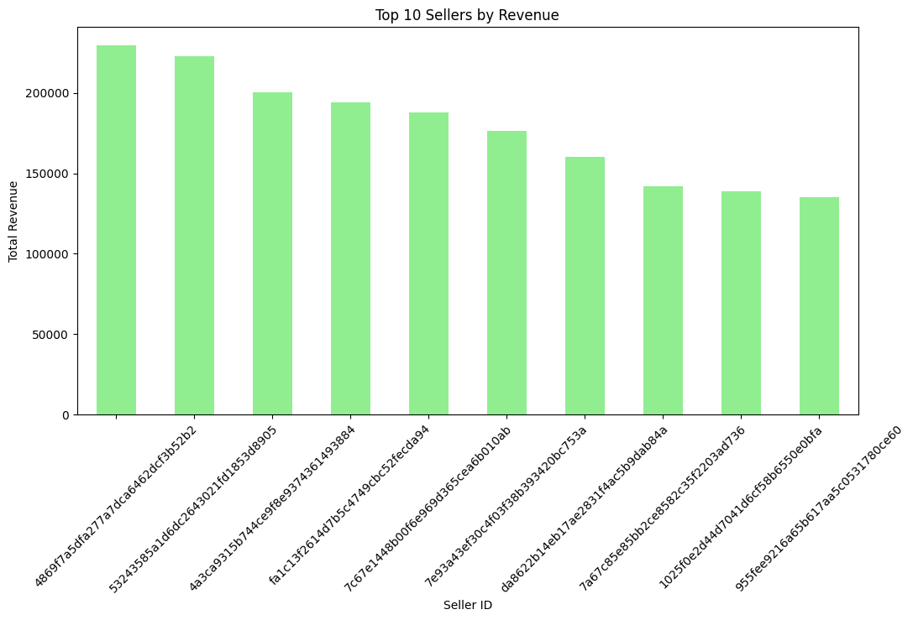
Top Sellers by Revenue
Insight: Revenue is highly concentrated among a few top sellers. Supporting emerging sellers could diversify growth.

Slide 5
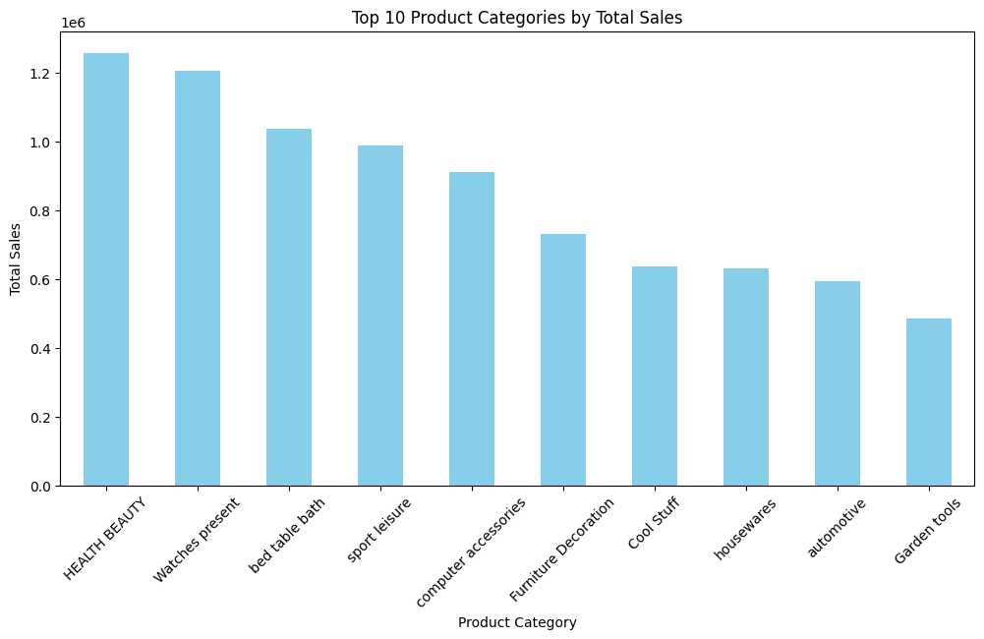
Top 10 Product Categories by Sales
Insight: Health & Beauty, Watches, and Bed/Table/Bath dominate sales. Opportunity exists to bundle and cross-sell related categories.

Slide 6
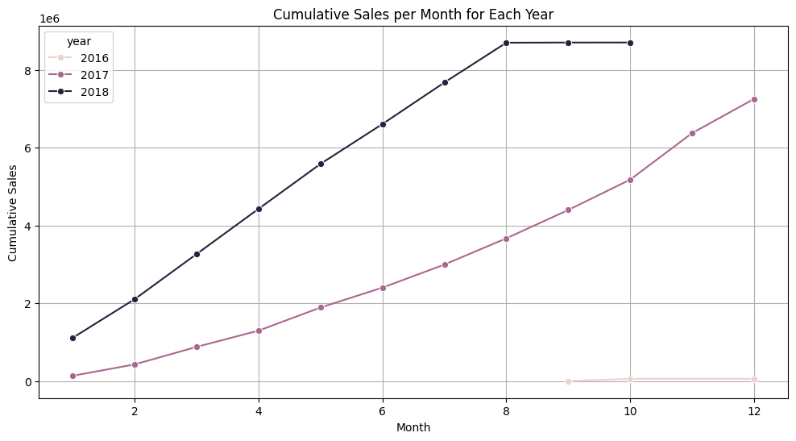
Cumulative Sales Growth by Year
Insight: 2017 and 2018 saw strong cumulative sales growth; momentum slowed by late 2018. Retention strategies are essential to sustain growth.

Slide 7
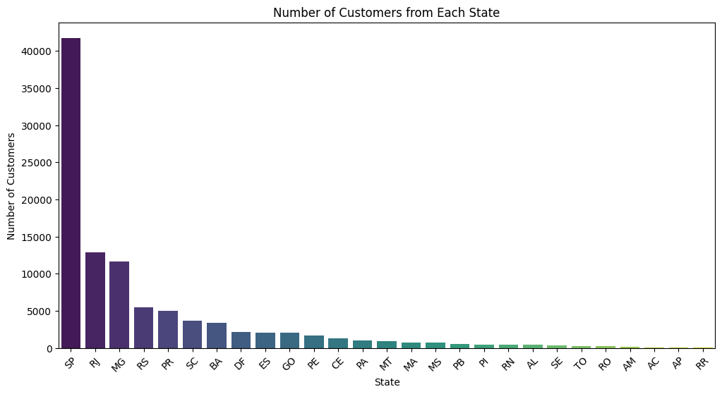
Customer Geographic Spread
Insights
Sao Paulo (SP) is the clear leader, with more customers than any other state by a large margin.
Rio de Janeiro (RJ) and Minas Gerais (MG) are strong secondary markets, but their customer counts are less than half that of SP.

Slide 8
Insights & Recommendations
Focus marketing on SP, RJ, MG to deepen presence
Expand popular product categories
Invest in customer retention (loyalty, targeted offers)
Continue flexible payment options (installments)
Train/support underperforming sellers
Premium engagement for top customers

Slide 9
Conclusion
The platform has built a strong presence in Brazil’s largest markets, with São Paulo, Rio de Janeiro, and Minas Gerais driving the bulk of transactions and revenue.
Early-stage explosive growth has stabilized, indicating the business is now entering a phase of market maturity. To maintain momentum, a shift in focus from rapid expansion to customer retention and long-term value is essential.
Despite a broad geographic reach, customer acquisition is highly concentrated—many states remain underpenetrated. This presents an opportunity to diversify growth by tailoring strategies for low-activity regions.
Retention rates are currently low, but this gives significant upside should effective loyalty strategies, personalized outreach, and re-engagement campaigns be deployed.
Flexible payments and a diverse product catalog are strong competitive advantages, matching customer preferences and allowing wider market appeal.

Slide 10
THANK YOU
Thank you for watching!
Contact :- vishalmaurya491@gmail.com
LinkedIn :- www.linkedin.com/in/vishal-maurya-a410b2261
GitHub :- https://github.com/vishal29102002

